Slide 1
Discrete Structure
Set Theory
Week 5
By
Dr. Rafiullah Khan

Slide 2
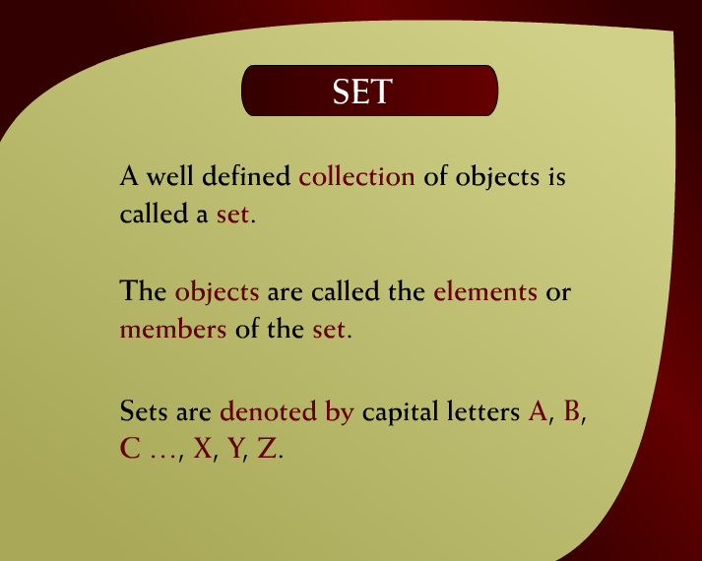
Set - (7 - 3)

Slide 3
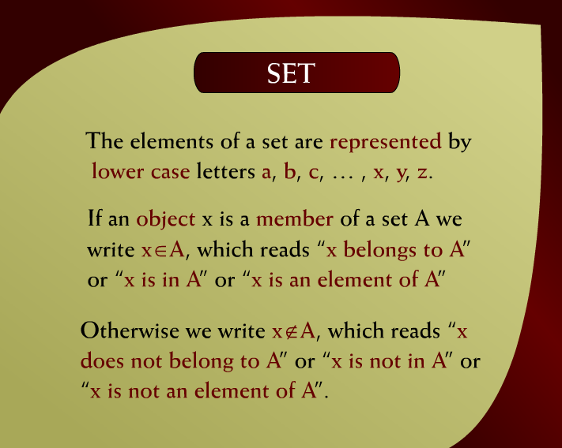
Set - (7 – 3a)

Slide 4
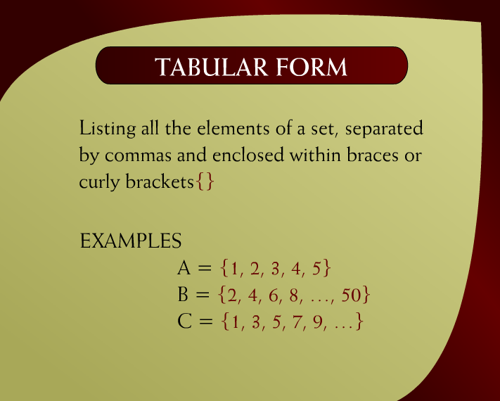
Tabular Form - (7 - 4)

Slide 5
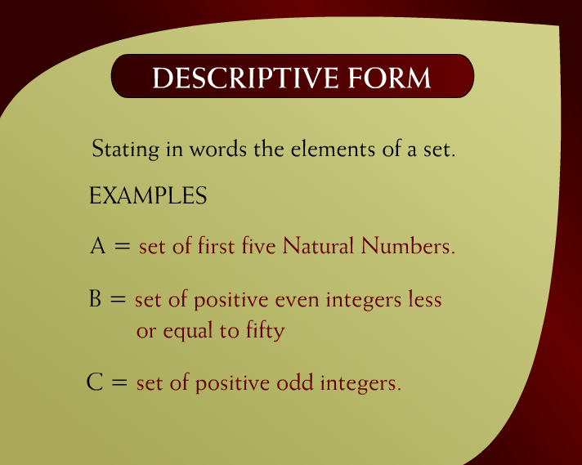
Descriptive Form - (7 - 5)

Slide 6
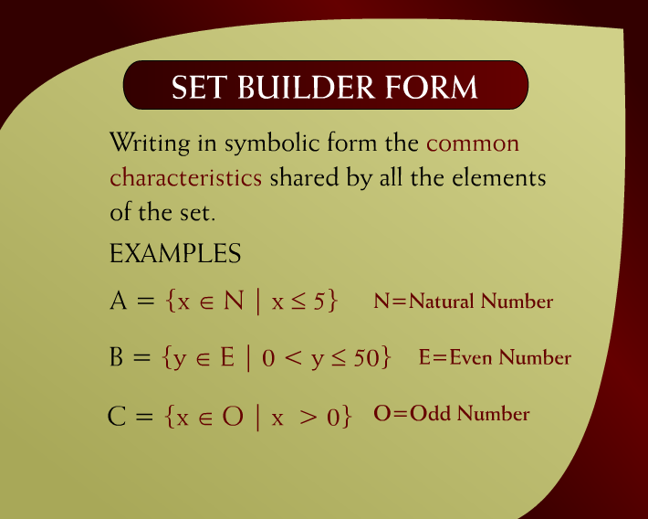
Set Builder Form - (7 - 6)

Slide 7
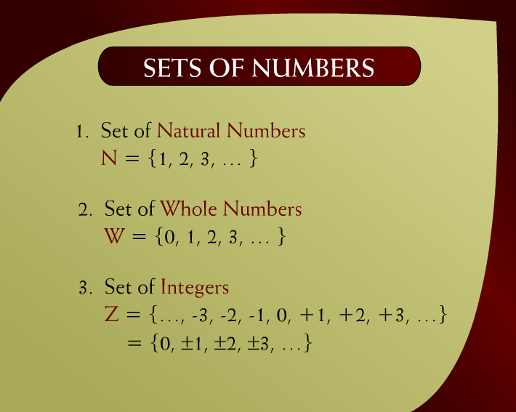
Set of Numbers – (7 - 7)

Slide 8

Set of Number – (7 – 7a)

Slide 9
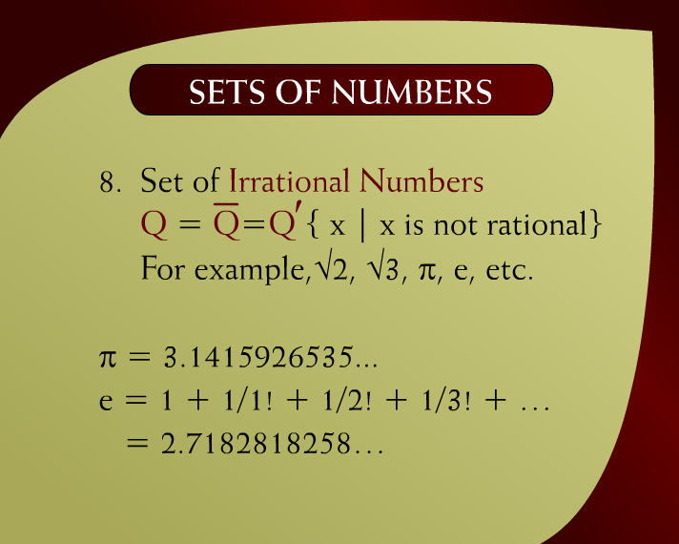
Set of Numbers – (7 – 7b)

Slide 10
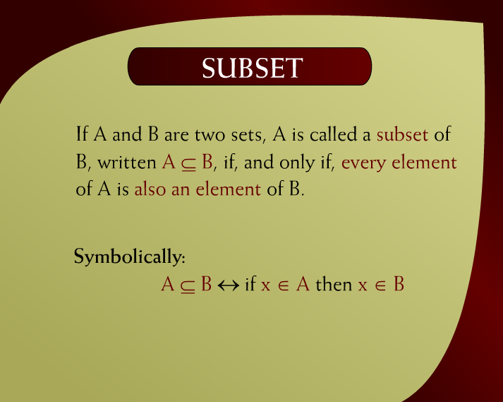
Subset – (7 - 10)

Slide 11
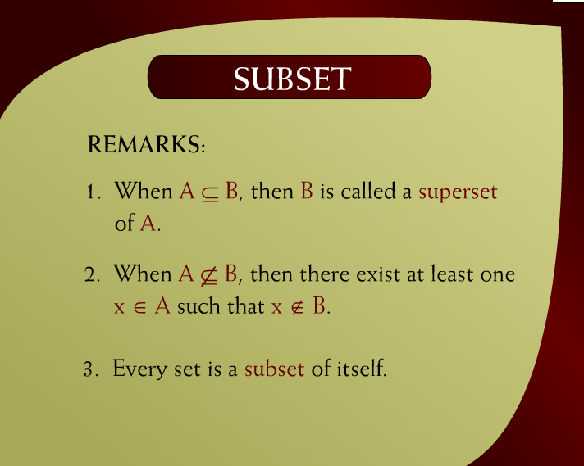
Subset – (7 – 10a)

Slide 12
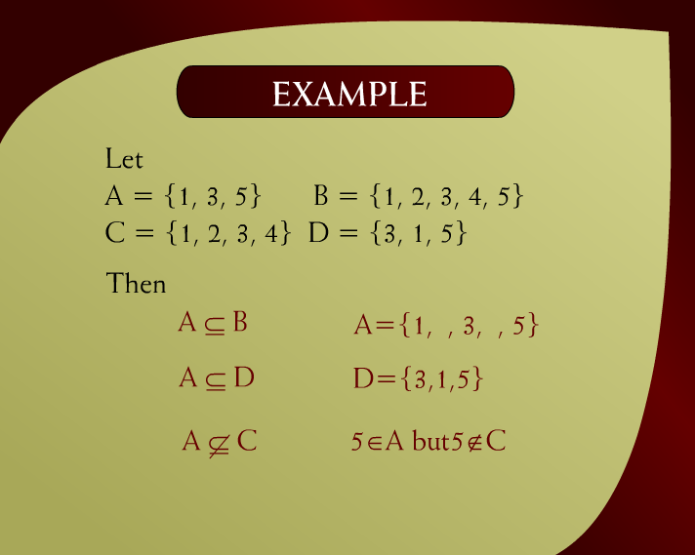
Example – (7 – 10a)

Slide 13
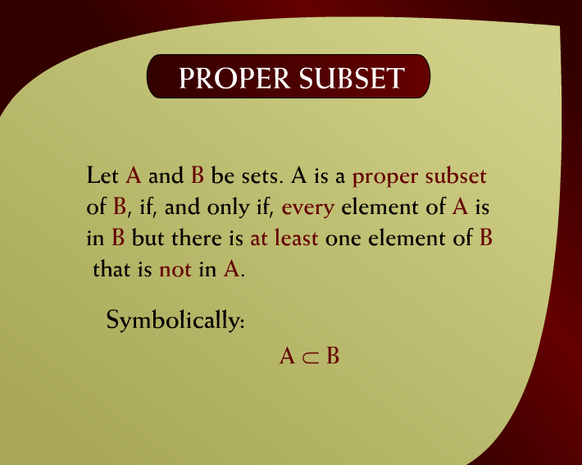
Proper Subset – (7 - 12)

Slide 14
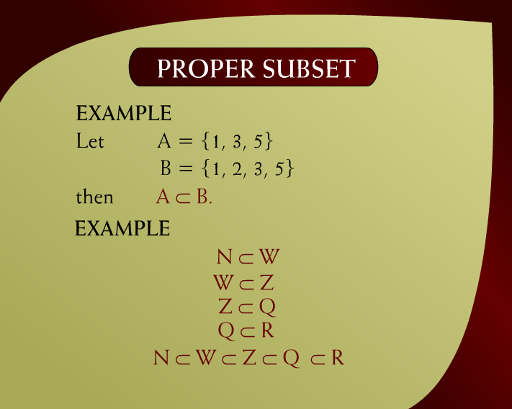
Proper Subset – (7 – 12a)

Slide 15
Quiz 1 in Next Class
Group A (16-Oct-2025)
Group B (17-Oct-2025)
Also don’t forget
Assignment 1 (Due date 20-Oct-2025)
Best of Luck

